Slide 1
Preparing data
Fatemeh Sarikhani

Slide 2
Test data : why?
Our brain is highly prone to overfitting
We will discover some patterns in the data and choose a ml model accordingly
But our estimate will be too optimistic and the model won’t perform as well as expected
Not having test data leads to overfitting

Slide 3
Test data: how? +code
We normally pick 20% of our data as test data,
We first write a function called train and test split:
import numpy as np
def split_train_test(data, test_ratio):
shuffled_indices = np.random.permutation(len(data)) test_set_size = int(len(data) * test_ratio)
test_indices = shuffled_indices[:test_set_size] train_indices = shuffled_indices[test_set_size:]
return data.iloc[train_indices], data.iloc[test_indices]

Slide 4
Test data: how? +code
Then we use this function on our dataset:
>>> train_set, test_set = split_train_test(housing, 0.2) >>> print(len(train_set), "train +", len(test_set), "test") 16512 train + 4128 test
Now we face a problem: if we run the program again, it will generate a new test set and over time our model will see a whole new dataset (which is what we want to avoid)
Q: what should we do to solve this issue?

Slide 5

We have 2 options:
One solution is to save the test set on the first run and then load it in subsequent runs.
Another option is to set the random number generator’s seed.

Slide 6
Using scikit learn to split data
Sklearn provides a function like the one we had before with 2 additional features:
There is a random state parameter
You can pass it multiple datasets (with identical number of rows
from sklearn.model_selection import train_test_split
train_set, test_set = train_test_split(housing, test_size=0.2, random_state=42)

Slide 7
What is the chance of getting nonbiased results when we choose pure random sampling?
For us population it’s only 12% when running a survey with the ratio of female population to male

Slide 8
The solution : stratified sampling
Stratified sampling is a technique that can help you improve the quality and efficiency of your machine learning models. It involves dividing your data into subgroups that share similar characteristics and then selecting a representative sample from each subgroup.

Slide 9
We can reach this goal by using a sklearn library:
from sklearn.model_selection import StratifiedShuffleSplit
split = StratifiedShuffleSplit(n_splits=1, test_size=0.2, random_state=42) for train_index, test_index in split.split(housing, housing["income_cat"]):
strat_train_set = housing.loc[train_index] strat_test_set = housing.loc[test_index]

Slide 10

Visualizing data
Why:
Take a quick glance of data
Discover some patterns in data
Tools:
Matplotlib
Seaborn
Pyplot px

Slide 11
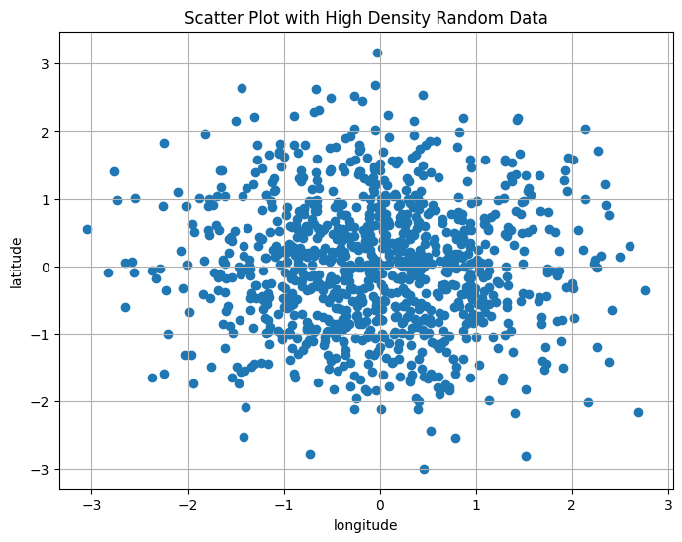
Visualizing geographical data
plt.figure(figsize=(8, 6))
plt.scatter(x, y)

Slide 12
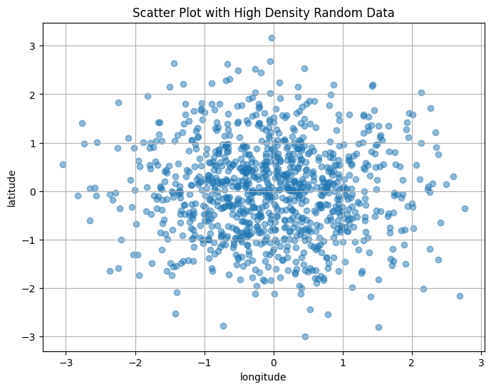
Visualizing geographical data
plt.figure(figsize=(8, 6))
plt.scatter(x, y, alpha = 0.5)

Slide 13
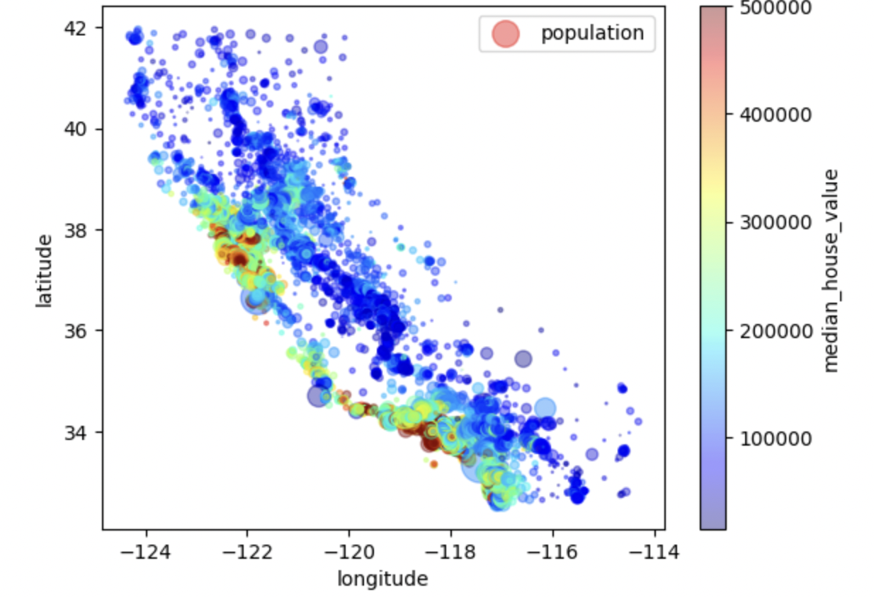
California house prices
Our brain is pretty good in discovering patterns, this could be useful in clustering algorithms

Slide 14
What are some ways to figure out the correlation of attributes in a dataset?
In California housing price dataset our target value is median house price and our attributes include longitude and latitude, being close to ocean, median income, …

Slide 15
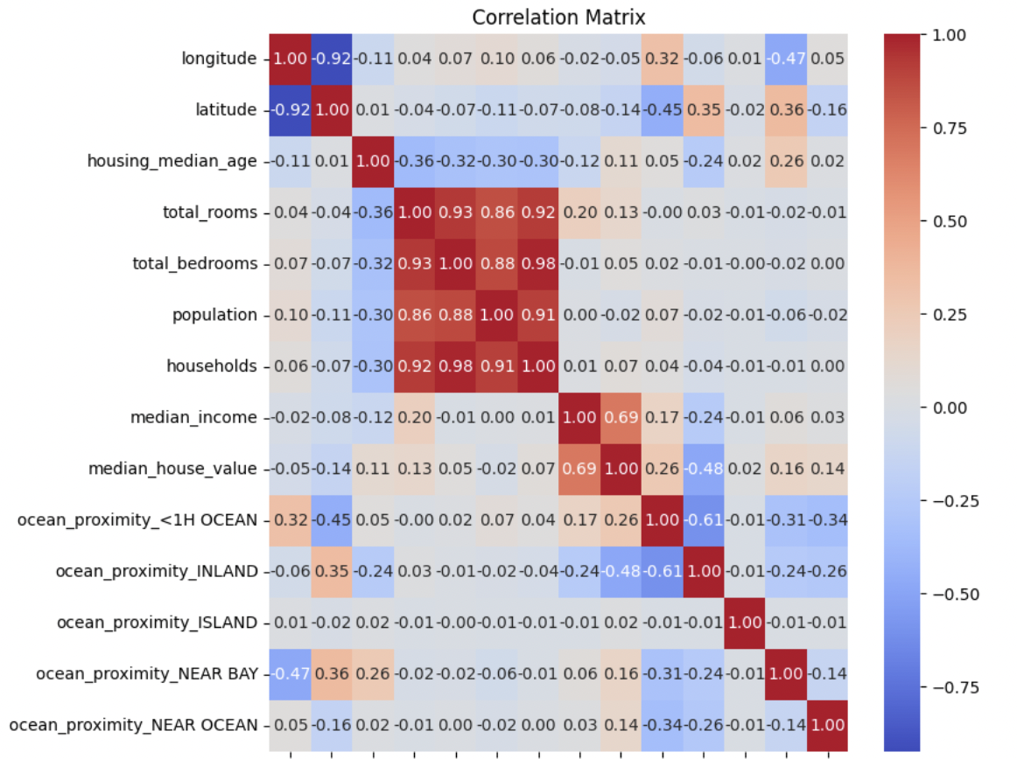
Correlation matrix
A correlation matrix is a statistical technique used to evaluate the relationship between two variables in a data set. The matrix is a table in which every cell contains a correlation coefficient, where 1 is considered a strong relationship between variables, 0 a neutral relationship and -1 a not strong relationship.
median_house_value 1.000000 median_income 0.688075 ocean_proximity_<1H OCEAN 0.256617 ocean_proximity_NEAR BAY 0.160284 ocean_proximity_NEAR OCEAN 0.141862
total_rooms 0.134153 housing_median_age 0.105623 households 0.065843 total_bedrooms 0.049686 ocean_proximity_ISLAND 0.023416 population -0.024650 longitude -0.045967 latitude -0.144160

Slide 16
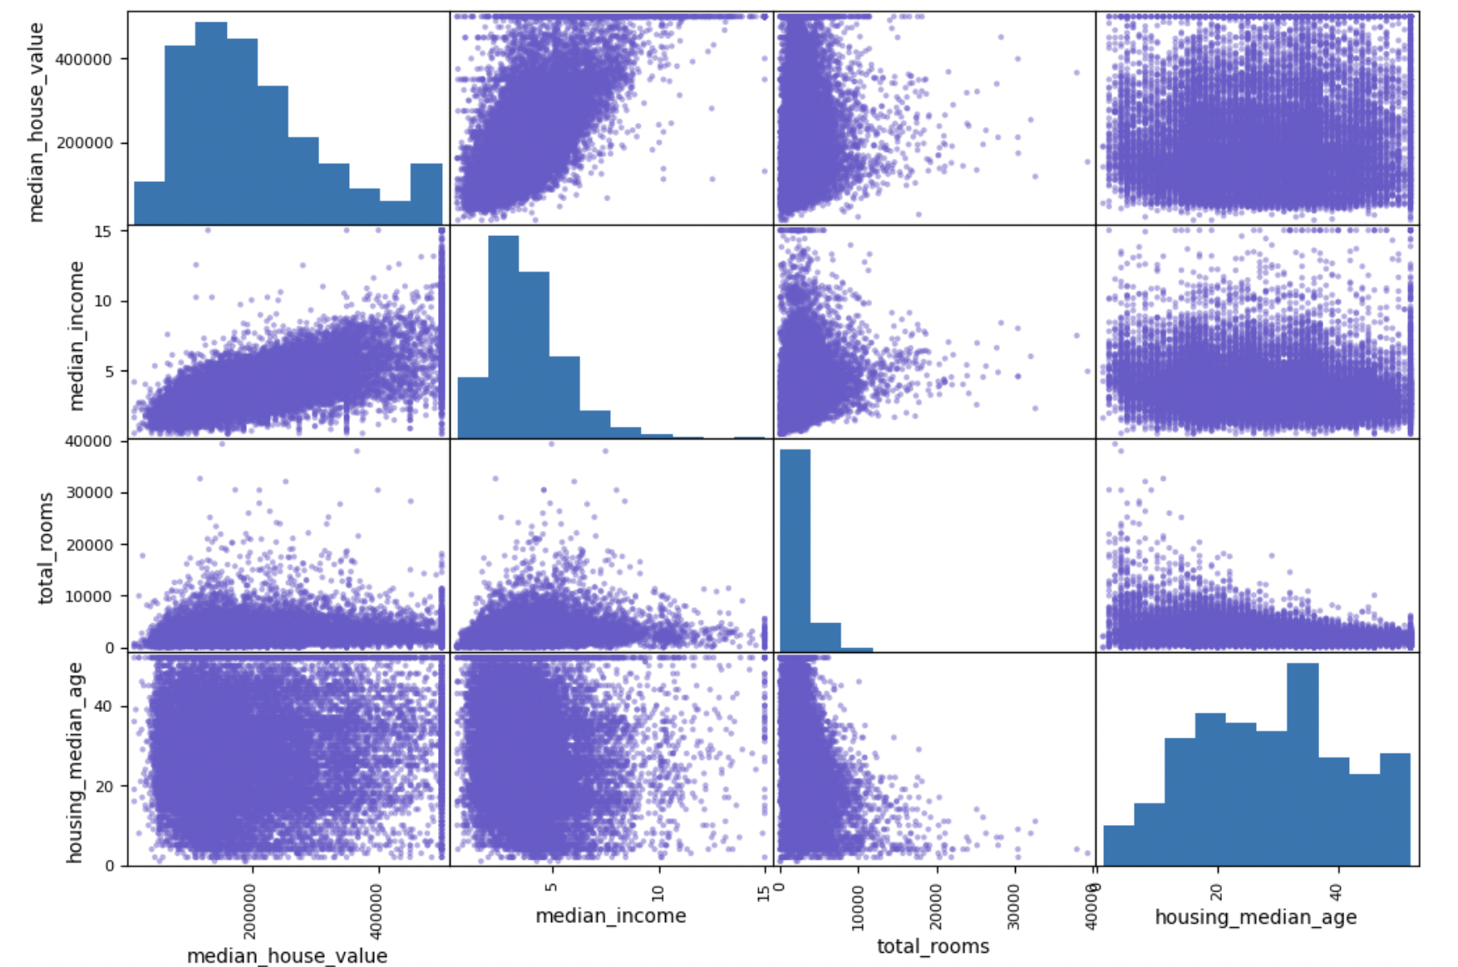
Matplotlib’s scatter plot
from pandas.plotting import scatter_matrix
attributes = ["median_house_value", "median_income", "total_rooms", "housing_median_age"]
scatter_matrix(df[attributes], figsize=(12, 8))
‘’’This plot reveals a few things. First, the correlation is indeed very strong; you can clearly see the upward trend and the points are not too dispersed. Second, the price cap that we noticed earlier is clearly visible as a horizontal line at $500,000. ’’’

Slide 17
Experimenting with Attribute Combinations
Experimenting with attribute combinations can provide valuable insights and improve the performance of machine learning algorithms.
Creating new attributes such as rooms per household, bedrooms per room, and population per household can lead to more informative features.
Correlation analysis reveals that attributes like bedrooms per room and rooms per household are more strongly correlated with median house value than raw attributes like total rooms or total bedrooms.

Slide 18
’’’It’s time to prepare the data for your Machine Learning algorithms. Instead of just doing this manually, you should write functions to do that.’’’
You can reproduce the transformations in future projects
You can extract them as a library and use it on any dataset

Slide 19
Data cleaning
Dealing with missing data
Get rid of the corresponding districts.
Get rid of the whole attribute.
Set the values to some value (zero, the mean, the median, etc.).
useful functions: drop(), dropna(), fillna()

Slide 20
Sklearn’s imputer
Sklearn provides a handy class to deal with the missing values, first you need to make an instance of the imputer with specifying how you want to fill the missing values (mean, median, most_frequent), then fit the impute on your dataset
from sklearn.preprocessing import Imputer
imputer = Imputer(strategy="median")
imputer.fit(housing_num)
More advanced imputers:
Knn imputer: replaces each missing value with the mean of the k_nearest neighbors values for that feature
Iterative imputer: makes a regression model per feature to predict the missing value and iterates a bunch of time to improve the model

Slide 21
SCIKIT-LEARN DESIGN
Easy to Use: Scikit-Learn has a consistent way of doing things, so you don't have to learn new tricks for each different tool. Whether you're estimating parameters, transforming data, or making predictions, the process is straightforward and similar across different tools.
Accessible Information: You can easily see what settings were used and what the model learned. This makes it easier to understand and trust the results.
Using Familiar Tools: Scikit-Learn uses standard tools like NumPy arrays and Python numbers, so you don't have to learn new data formats or ways of working with data.
Mix and Match: You can combine different tools to create more complex models. For example, you can chain together data transformers and prediction models to create a pipeline that does everything you need.

Slide 22
Bonus: visualize your dataset with one line of code!
With AutoViz, you can easily and quickly generate insightful visualizations for your data. Whether you're a beginner or an expert in data analysis, AutoViz can help you explore your data and uncover valuable insights. Try it out and see the power of automated visualization for yourself!
Learn more

Slide 23
Thank you!
you can access the data, code and slides in the following github repo: https://github.com/Fsrkh/ml-book-presentation-.git
Please keep this slide for attribution

